Slide 1
Design And Implementation Of Electricity Bill Payment
Project Done By
Joseph Stephy J

Slide 2

About Intel Company:

Slide 3

Intel corporation, situated in Santa Clara, California, is the worldwide leader in manufacturing computer chips for PCs, with revenues of over $21 billion. Intel was founded in 1968 by Robert Noyce and Gordon Moore, when they decided to leave the transistor company they had helped start, Fairchild Semiconductor.

Slide 4


*The Internship Certificate Was Given By Intel Industry Located At Bangalore.
.

Slide 5
*During this internship I have learned about state Machine diagram,FPGA ,Test branch and block diagram construction and Verilog HDL code. *Pin Diagram,State Machine Diagram is thought by our industrial mentor. *Flow Diagram and testing and feasibility of this project is thought.
This project is completely thought and guided by my mentor Dr.K.Padmanaban Who is from Intel Industry.

Slide 6
FPGA:
Field Programmable Gate Arrays (FPGAs) are semiconductor devices that are based around a matrix of configurable logic blocks (CLBs) connected via programmable interconnects. FPGAs can be reprogrammed to desired application or functionality requirements after manufacturing. This feature distinguishes FPGAs from Application Specific Integrated Circuits (ASICs), which are custom manufactured for specific design tasks. Although one-time programmable (OTP) FPGAs are available, the dominant types are SRAM based which can be reprogrammed as the design evolves.
State machine diagram:
State machine diagram typically are used to describe state-dependent behavior for an object. An object responds differently to the same event depending on what state it is in. State machine diagrams are usually applied to objects but can be applied to any element that has behavior to other entities such as: actors, use cases, methods, subsystems systems and etc. and they are typically used in conjunction with interaction diagrams

Slide 7
Aim Of The Project:
.Electricity Billing System is a software-based application.
i. This project aims at serving the department of electricity by
computerizing the billing system.
ii. It mainly focuses on the calculation of units consumed during the
specified time and the money to be charged by the electricity offices.
iii. This computerized system will make the overall billing system easy,
accessible, comfortable, and effective for consumers.

Slide 8
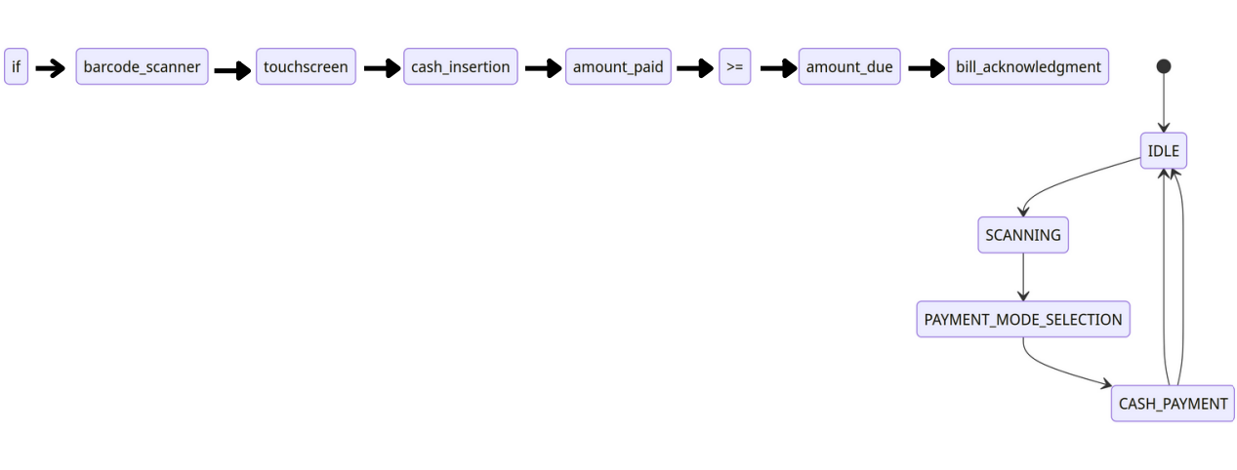
BLOCK DIAGRAM

Slide 9
Algorithm (Steps):
1.Initialize the variables and registers: -Initialize the state variable to IDLE
state. -Set the output registers (dis, successful, paidamt) to their initial values. -
Initialize the totalcurrency, storedExcessAmount, and storedInsufficientAmount
registers to zero. -Initialize the currentAmount, excessAmount,
insufficientAmount, amt, and due variables to zero.
2. Define the state transition logic: -On every positive edge of the clock (clk),
check if the system is in the reset state (rst). -If rst is active, set the state to
IDLE. -If rst is not active, set the state to the next_state determined in the
previous cycle.
3.Define the state-based behavior: -Use a combinational always @(*) block to
determine the behavior based on the current state. -Inside the always @(*)
block, use a case statement to evaluate the current state. -Based on the current
state, define the behavior for each state. ANY TIME ELECTRICITY BILL
PAYMENT MACHINE.

Slide 10
4. IDLE state: -Set the dis, successful, totalcurrency, and paidamt outputs to
their default values. -Check the choice input to determine the next state: -If
choice is 2'b01 (DD_IN), transition to the DD_IN state. -If choice is 2'b10
(CURRENCY_IN), transition to the CURRENCY_IN state.
5. DD_IN state: -Set the currentAmount to the ddamt input. -Transition to the
CALCULATIONS state.
6. CURRENCY_IN state: -Based on the currency input, update the
currentAmount with the corresponding currency value. -If the currency input is
invalid, keep the currentAmount unchanged. -Transition to the
CURRENCY_IN state to allow for continuous currency inputs. -If the currency
input is 4'b1000 (end of currency input), transition to the CALCULATIONS
state.

Slide 11
7.CALCULATIONS state: -Calculate the due amount by adding the
paymentAmount and storedInsufficientAmount. -Calculate the total amount
(amt) by adding the currentAmount and storedExcessAmount. -Compare the
amt with the due amount: -If amt is greater than or equal to due, calculate the
excessAmount, set the insufficientAmount to zero, -update the
storedExcessAmount, and transition to the SUCCESS state. -If amt is less than
due, calculate the insufficientAmount, set the excessAmount to zero, -update the
storedInsufficientAmount, and transition to the FAILED state.
8 .SUCCESS state: -Set the successful output to 1, dis output to 0. -Update the
totalcurrency with the currentAmount. -Update the paidamt with the
paymentAmount. -Transition back to the IDLE state.
9. FAILED state: -Set the successful output to 0, dis output to 1. -Update the
totalcurrency with the currentAmount. -Update the paidamt with the
paymentAmount. -Transition back to the IDLE state.
10.Default case: -If the current state is not explicitly handled, transition back to
the IDLE state.

Slide 12
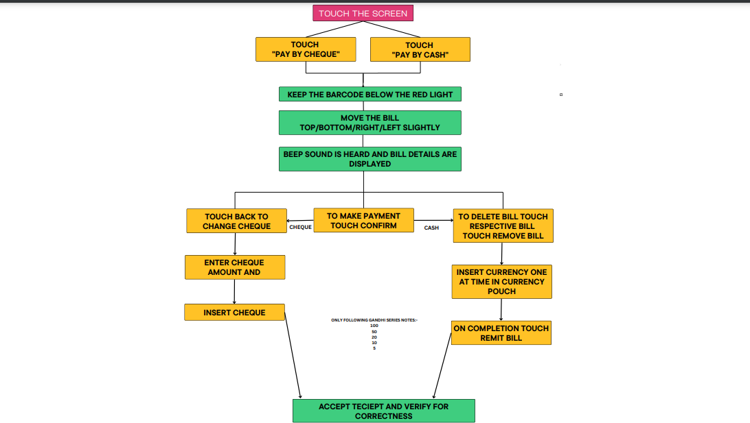
Flow Diagram

Slide 13
Unit Testing:
Unit testing focuses verification effort on the smallest unit of
software design the module. The software built, is a collection of
individual modules. In this kind of testing exact flow of control
for each module was verified. With detailed design consideration
used as a guide, important control paths are tested to uncover
errors within the boundary of the module.
Integration testing:
The second level of testing is called integration testing. In this, many class-tested modules are combined into subsystems, which are then tested. The goal here is to see if all the modules can be integrated properly. We have been identified and debugged.
Testing
Note:
How The Two Testings Are Done Is Explained In MY Report

Slide 14
The Code For Verilog HDL is provided in my GITHUB account
Both Verilog and test branch code are also attached it in my report

Slide 15
1.Design and Simulation: Write the Verilog code for the ATP machine controller module and create a testbench for simulation to verify its functionality.
2. Synthesis: Use a synthesis tool to convert the Verilog code into a gate-level netlist,optimizing the design for the target technology.
3. Pin Planning: Determine the pin configuration and mapping of the ATP machine controller to the target device, ensuring compatibility and meeting any necessary constraints.
4. Chip Planning: Define the overall architecture and organization of the chip, including placement and routing strategies for the ATP machine controller within the chip.
In Which Steps I Have Implemented It Is Shown

Slide 16
5. Labs Land Implementation: Perform the physical implementation process, including place and route, to implement the design on the target device.
6. Performance Evaluation: Perform post-layout simulations to verify the functionality and measure key performance metrics such as timing, power consumption, and area utilization.
These six steps provide a high-level overview of the main stages involved in the implementation of the ATP machine controller.

Slide 17
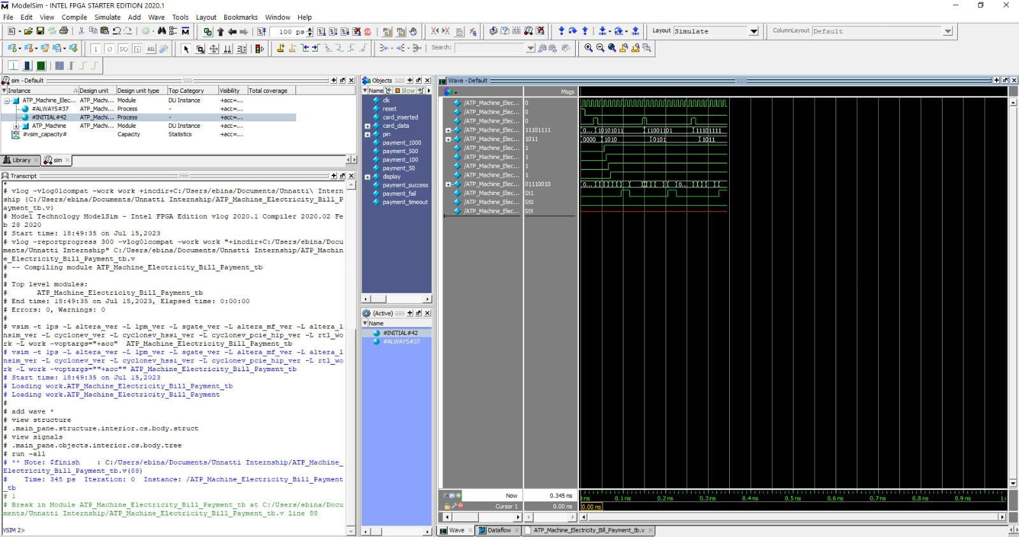
Data Flow Diagram:(Output)

Slide 18
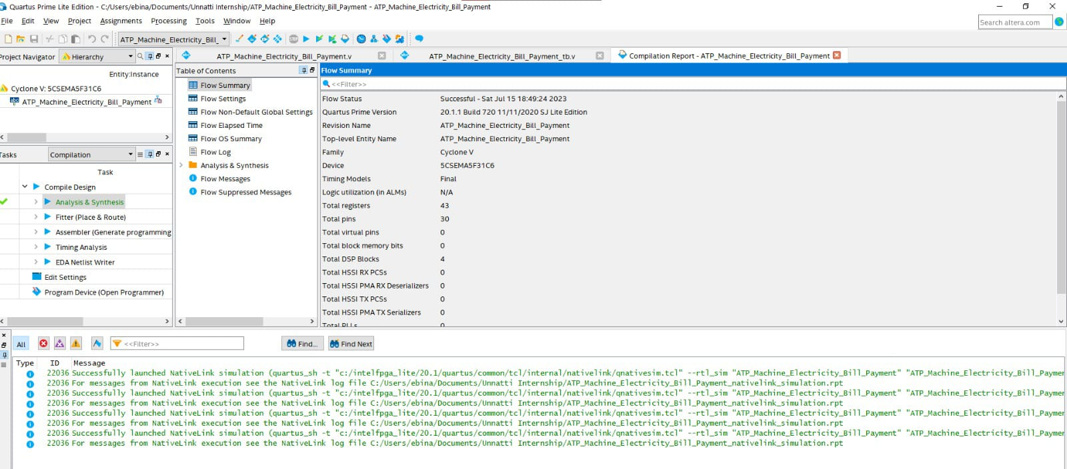
Output(Success screenshot):

Slide 19
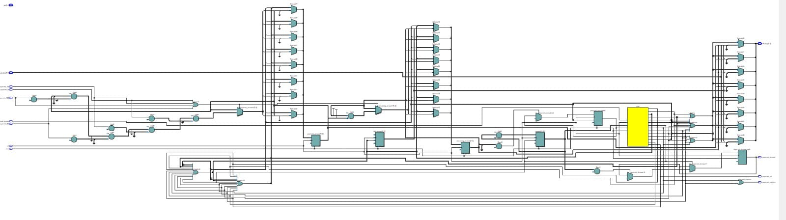
State Diagram:

Slide 20
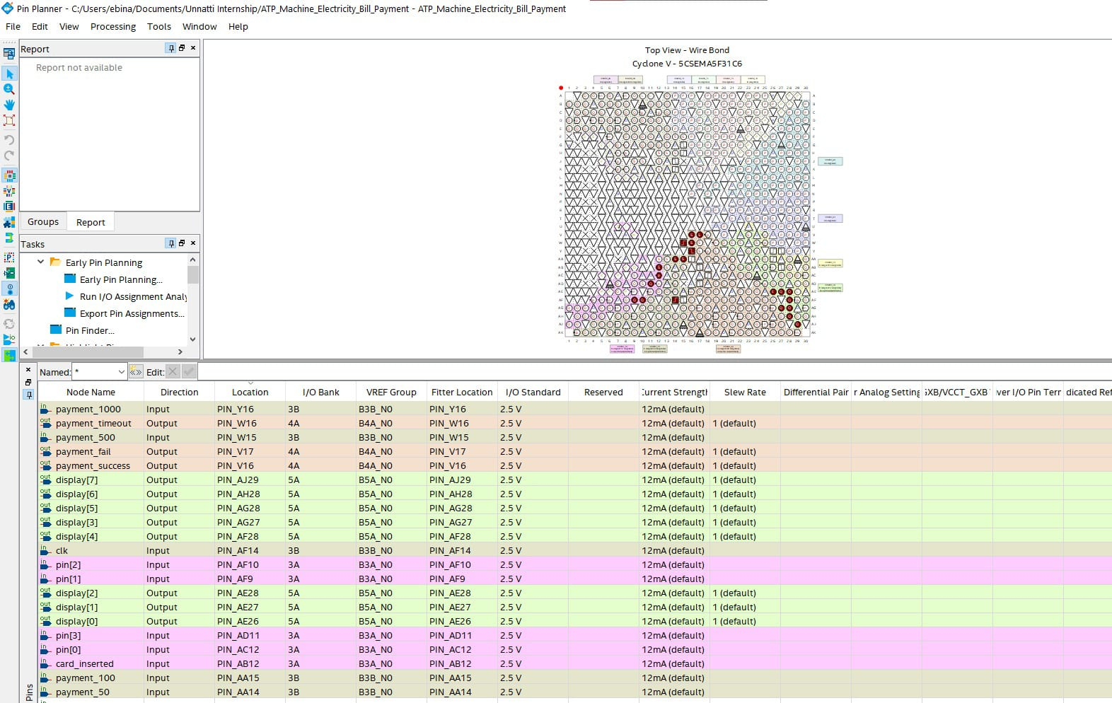
Pin Diagram:

Slide 21
Conclusion:
In conclusion, the implemented electricity payment system using Verilog HDL successfully handles barcode scanning, enables payment mode selection, and facilitates cash payment processing.
The system exhibits robust behavior, accurately calculates amounts due and paid, and efficiently dispenses change. It provides a reliable and efficient solution for processing electricity bill payments. Future improvements can include support for additional payment modes and enhanced security measures.
Overall, the project demonstrates the effectiveness of Verilog HDL in designing and implementing electronic payment systems.

Slide 22
Fulture Analysis:
We have left all the options open so that if there
is any other future requirement in the system by the user for
the enhancement of the system then it is possible to implement them.
We hope that the project will serve its purpose for
which it is develop there by underlining success of process.

Slide 23
THANK YOU

